Slide 1

Implementation

Slide 2
DL Regularization & Optimization
Regularization
Weight Initialization
He or Kaiming Initialization
Dropout
Before FC
Probability = 0.1
L2 regularization
Weight Decay = 1e-3
Early Stopping
Initial Epochs = 1000
Optimization
Mini Batch SGD
Adam
Batch Size = 64
Learning Rate Scheduling
OneCycleLR
Maximum Learning Rate = 0.01

Slide 3
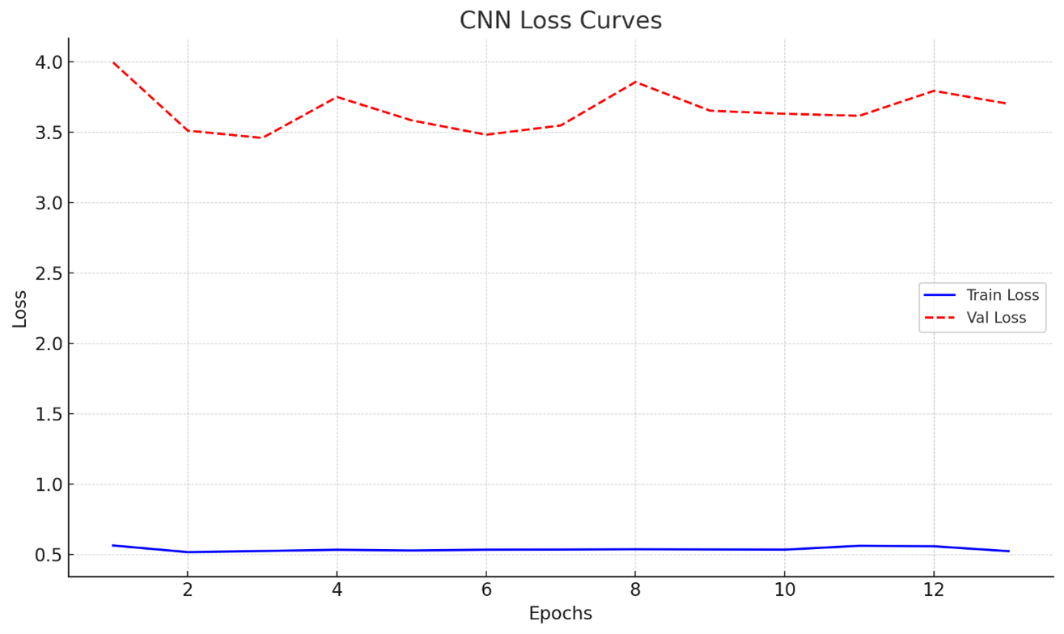

Slide 4
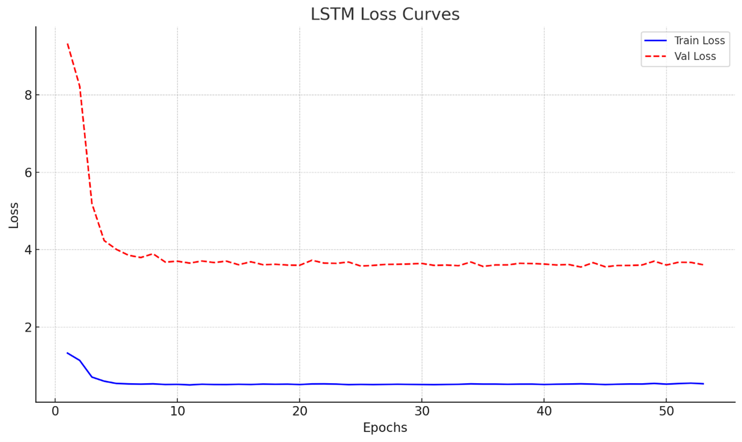

Slide 5
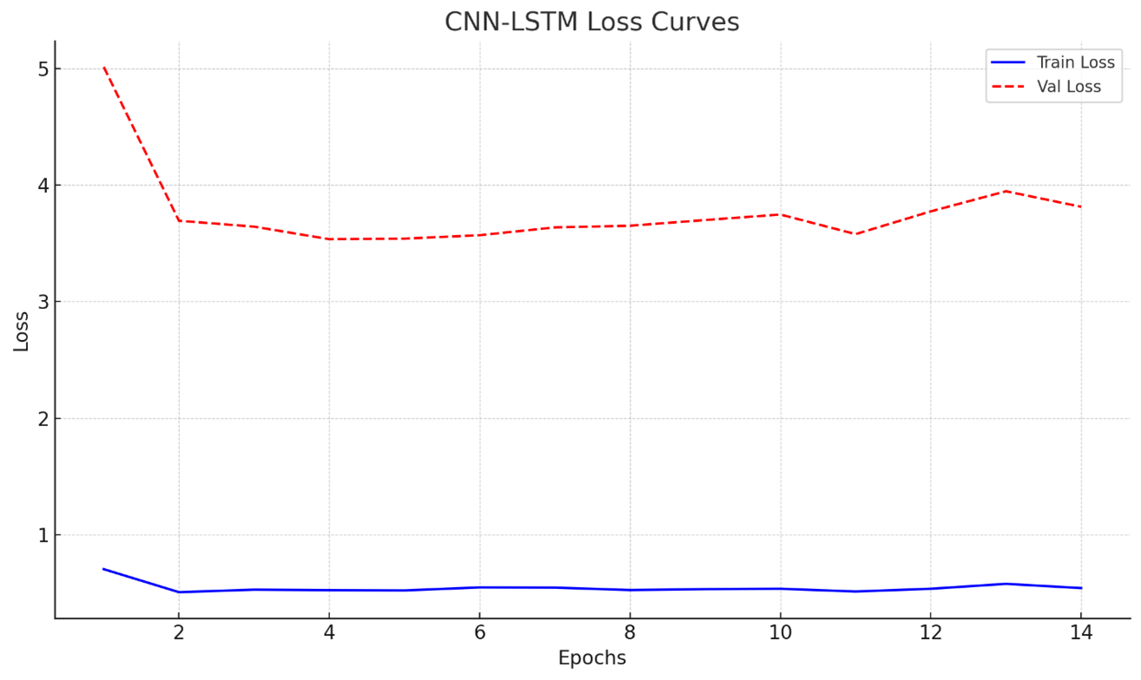

Slide 6
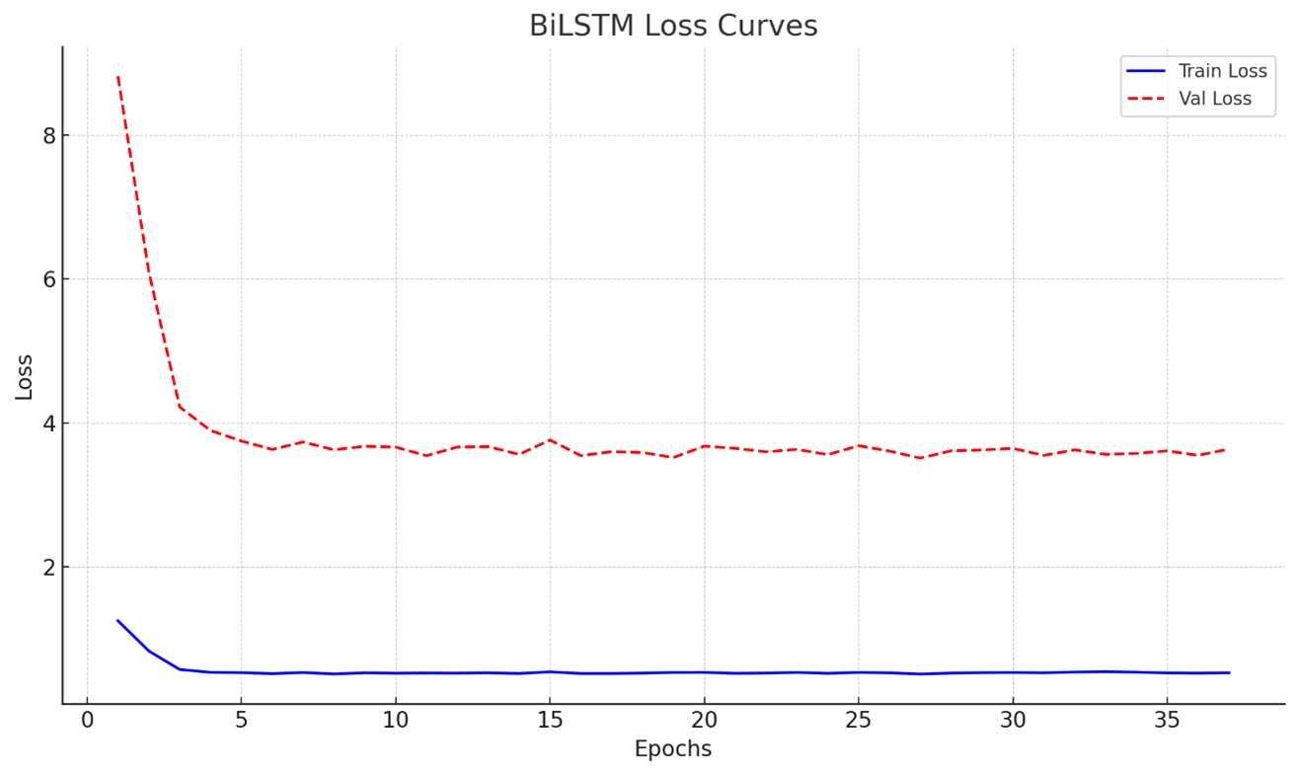

Slide 7
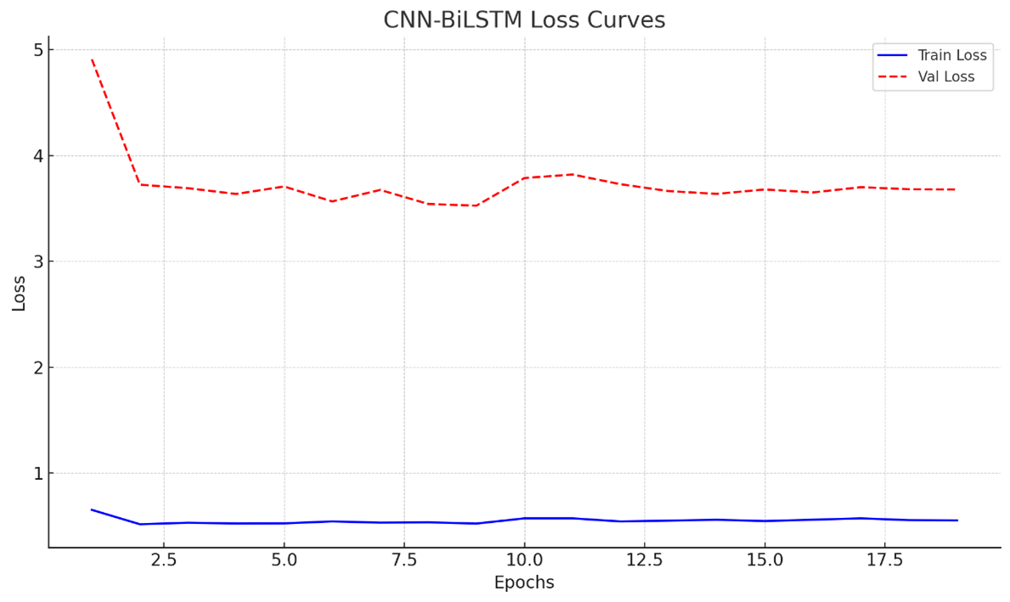

Slide 8
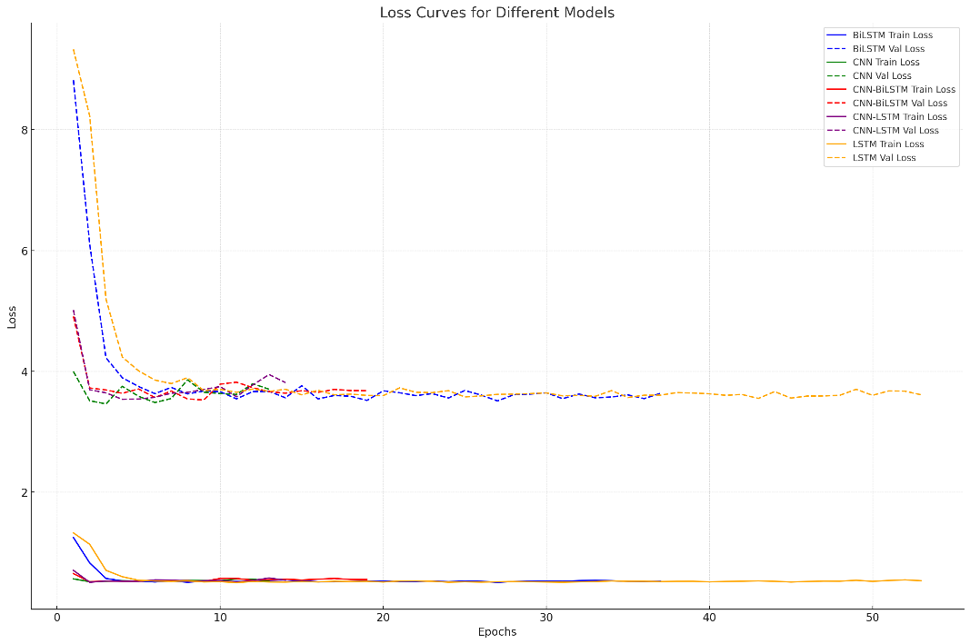

Slide 9
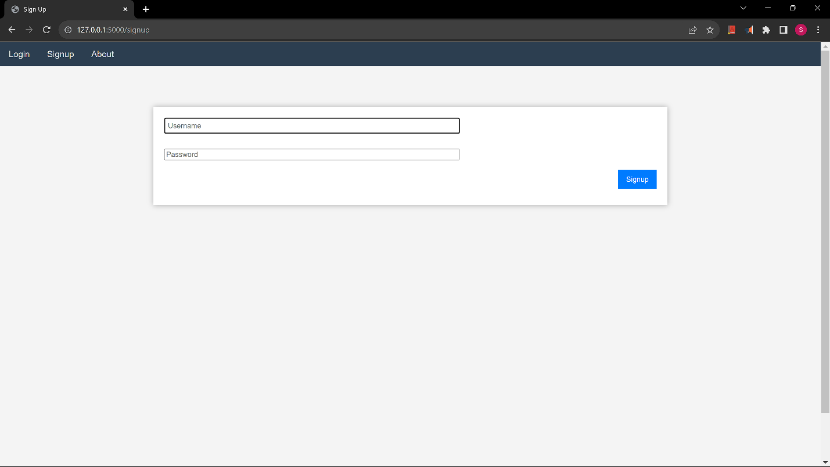

Slide 10
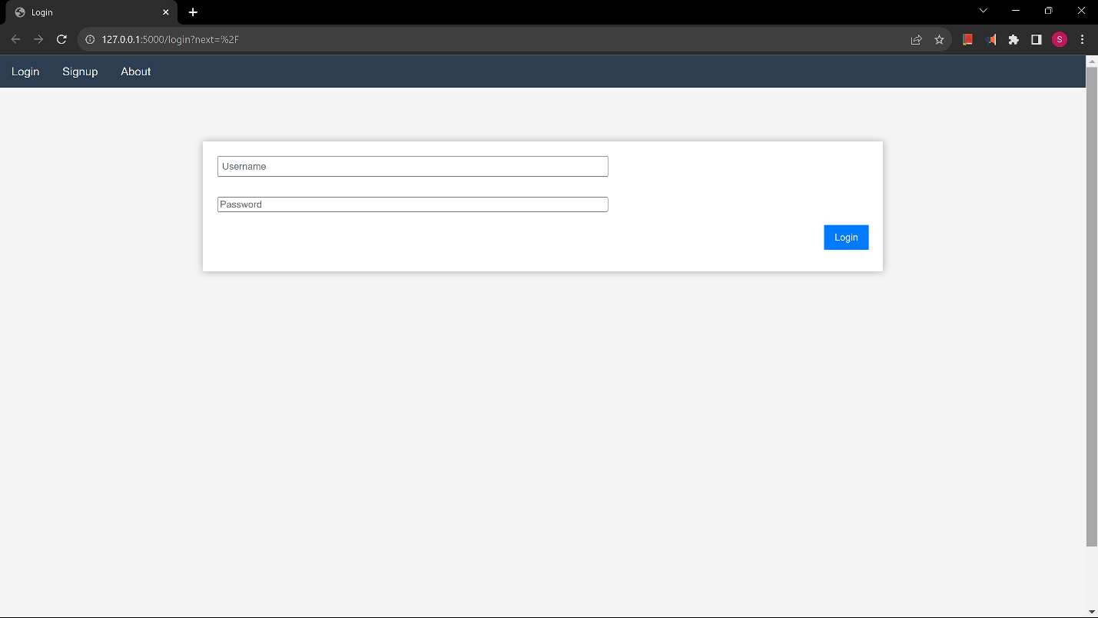

Slide 11
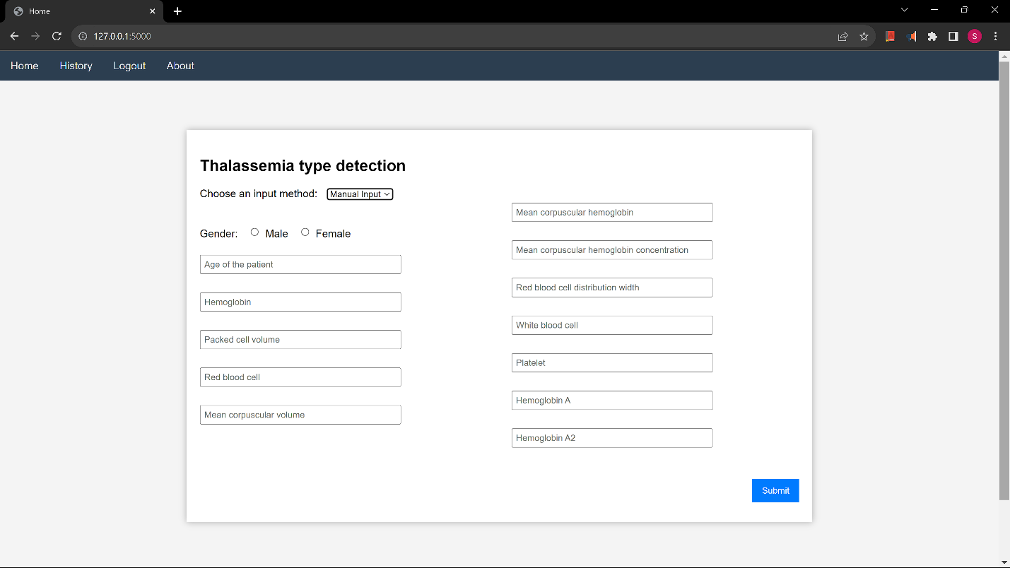

Slide 12
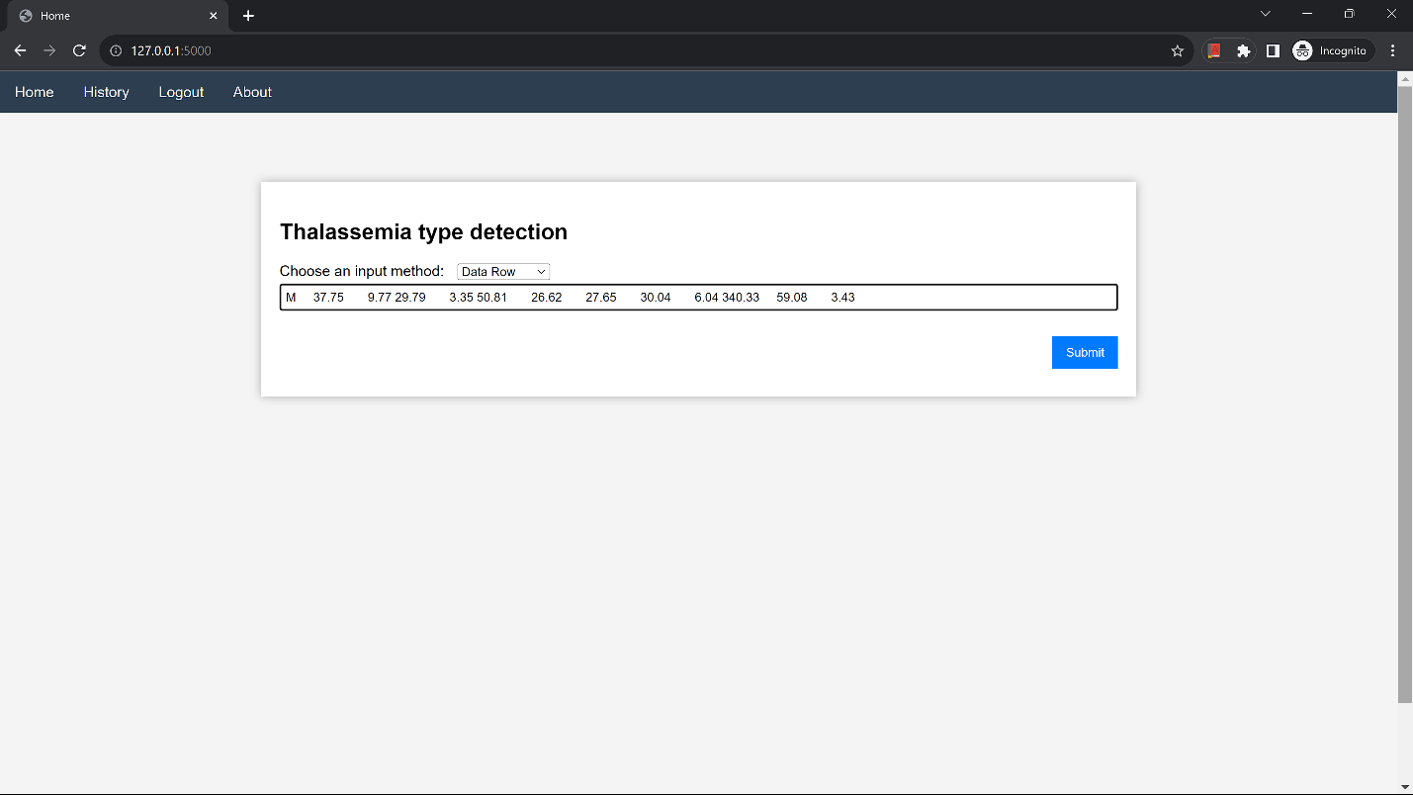

Slide 13
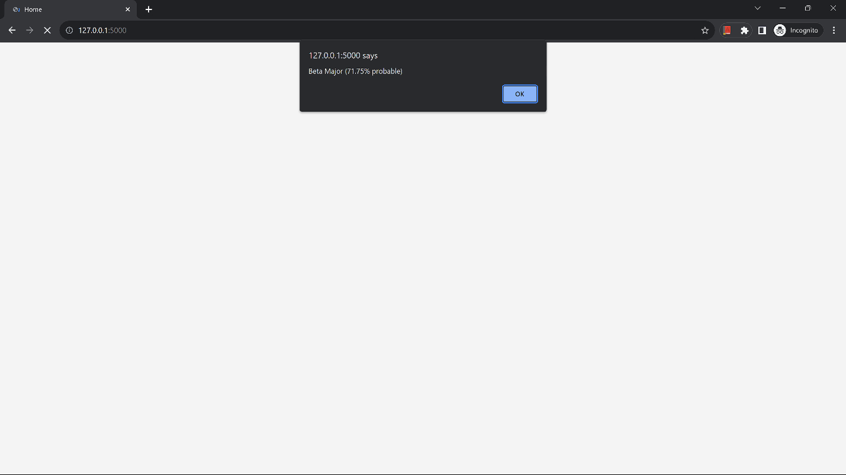

Slide 14
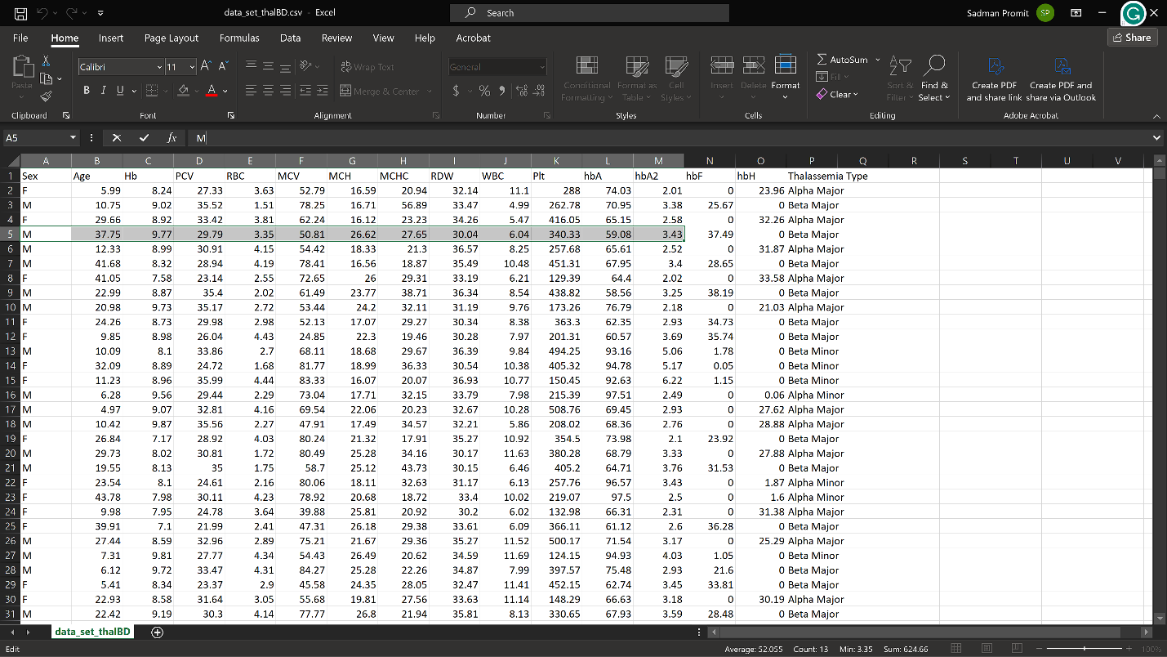

Slide 15
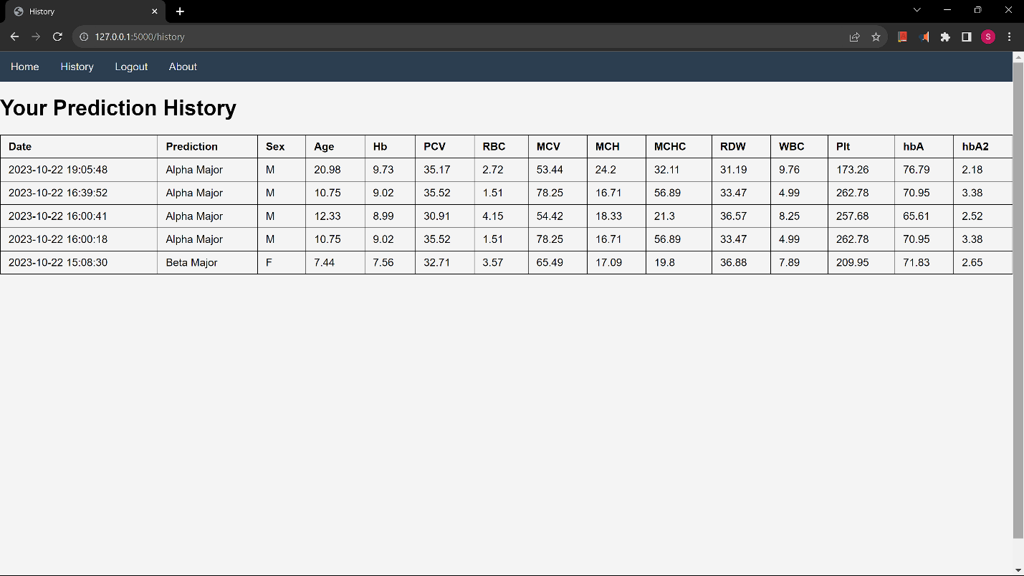

Slide 16
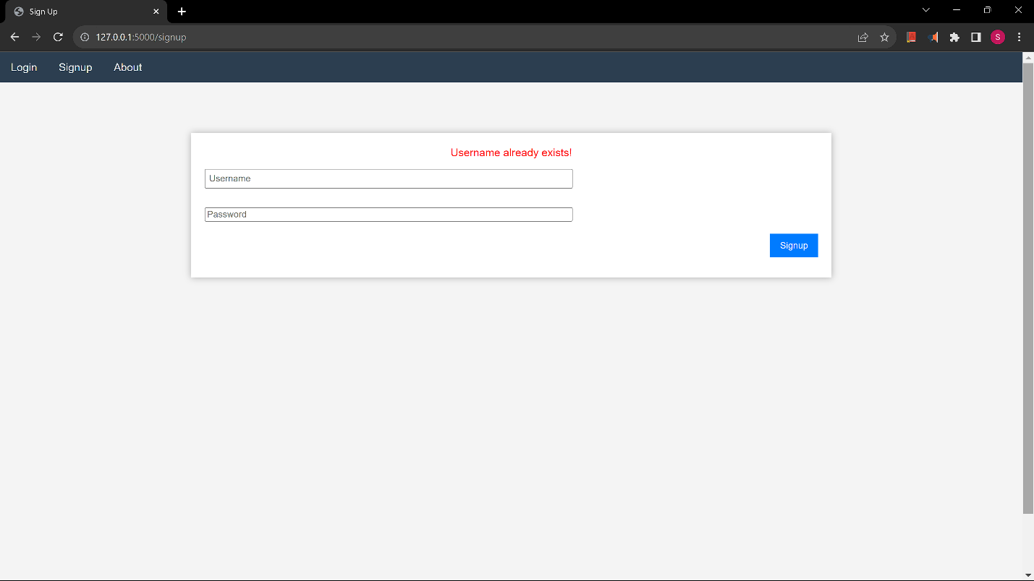

Slide 17


Slide 18
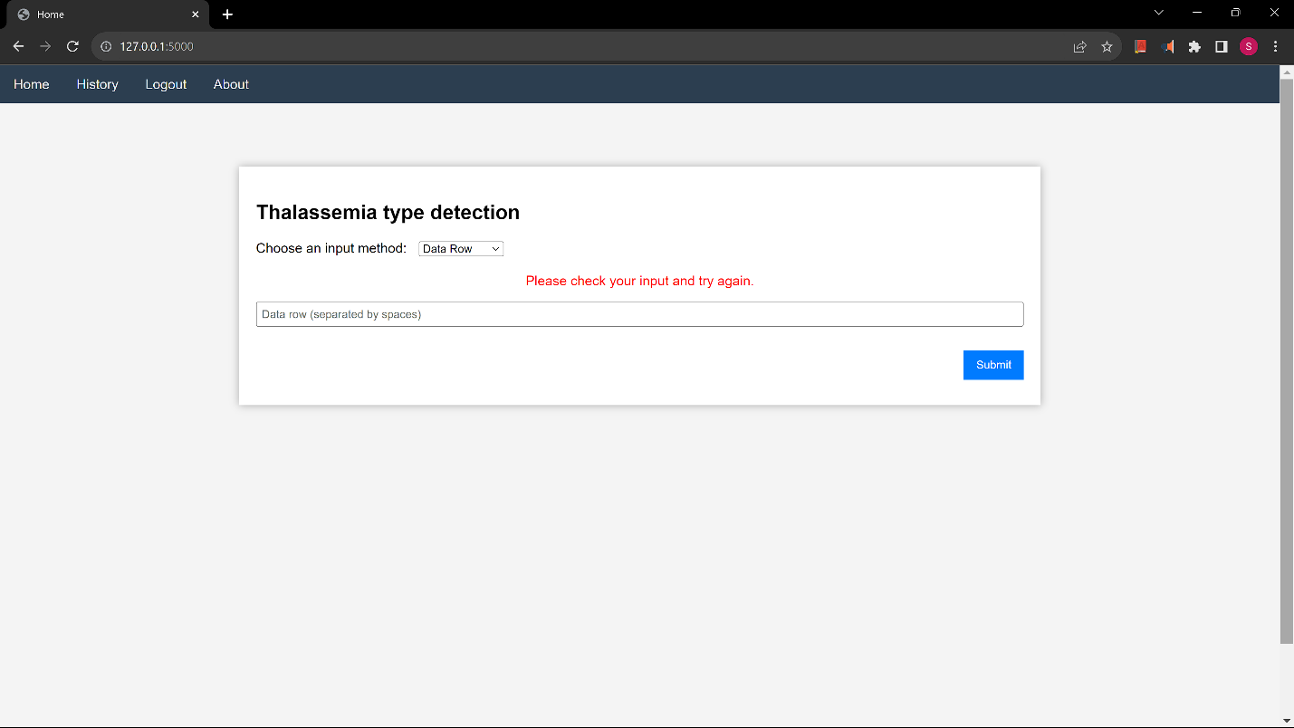

Slide 19
